Slide 1
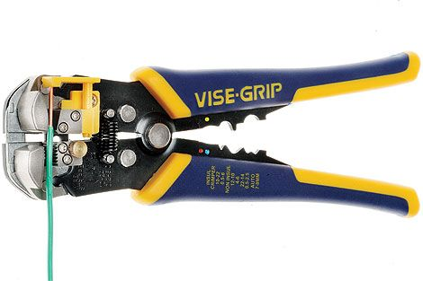
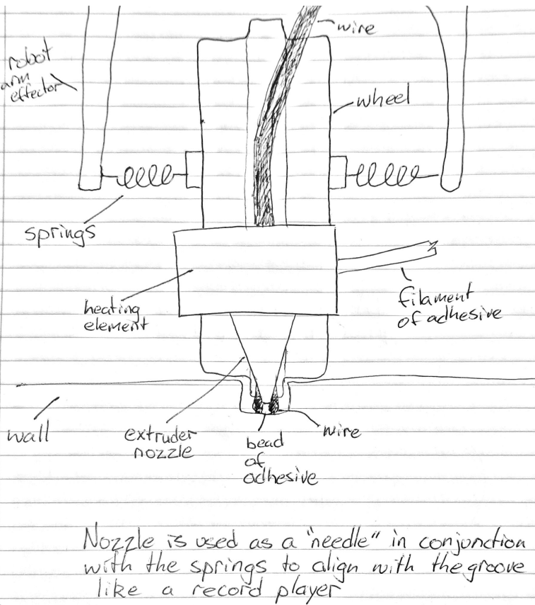
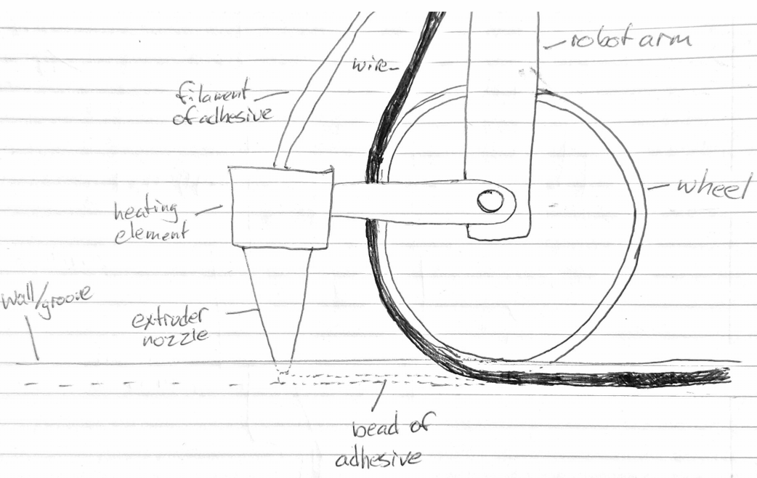
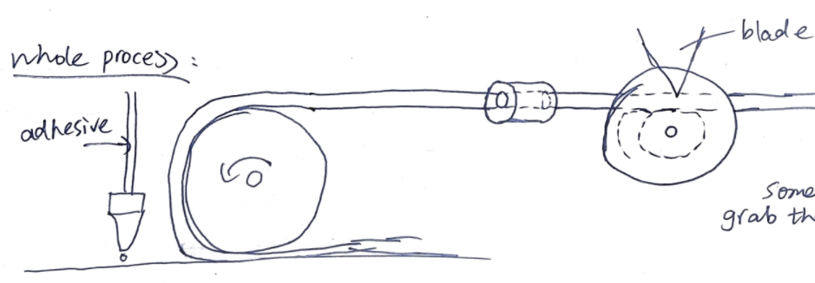
Russell and Zach
Conceptual designs combined together to create a working whole - or separated for use in different solution
Potential Process: Repeated use of static mounted wire-stripping tool
Potential solution for groove-alignment, adhesive-
extrusion & rolling-cable-layer
Side view:
Potential Process:
Use a separator to separate each core by wire stripping with a moveable blade

